Slide 1

THE MOST POWERFUL CONCEPT IN MEDICINE
THE LOW ENERGY STATE

Slide 2
Who Uses Energy?
Rapidly Dividing Cell Lines
  SKIN
  HAIR
  GI
  RESPIRATORY
  RENAL(PCT)
  BLADDER
  ENDOMETRIUM
  ENDOTHELIUM
  BREASTS
  SPERM
  GERM CELLS
  CUTICLES
  BONE MARROW
    RED BLOOD CELLS
    WHITE BLOOD CELLS
    PLATELETS
Less Rapidly Dividing Cell Lines
BRAIN
MUSCLES
PRIMARY ACTIVE TRANSPORT
HEART
MEMBRANE MOVEMENT

Slide 3
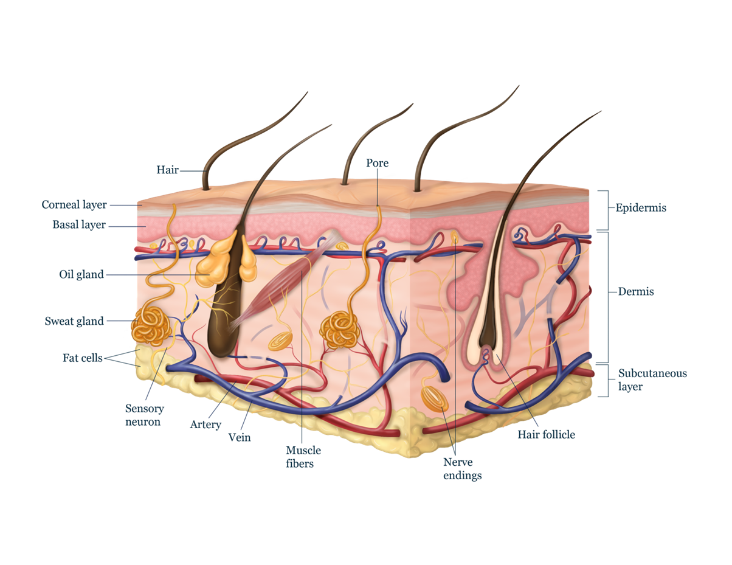
SKIN, HAIR & NAIL CELLS
Figure 1.1 Epithelial Cells (Skin, Hair, and Nail)

Slide 4
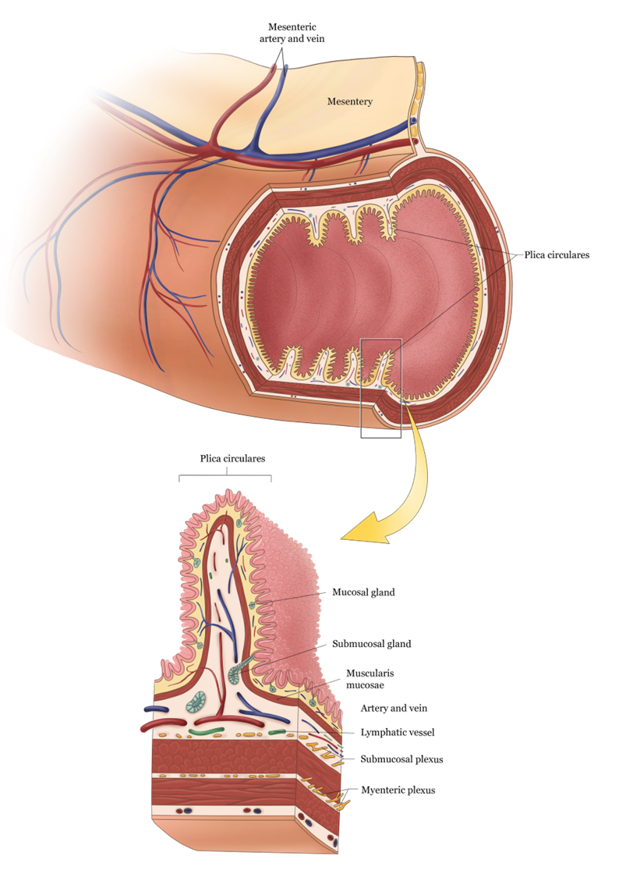
GI TRACT
Figure 1.2 Small Intestine

Slide 5
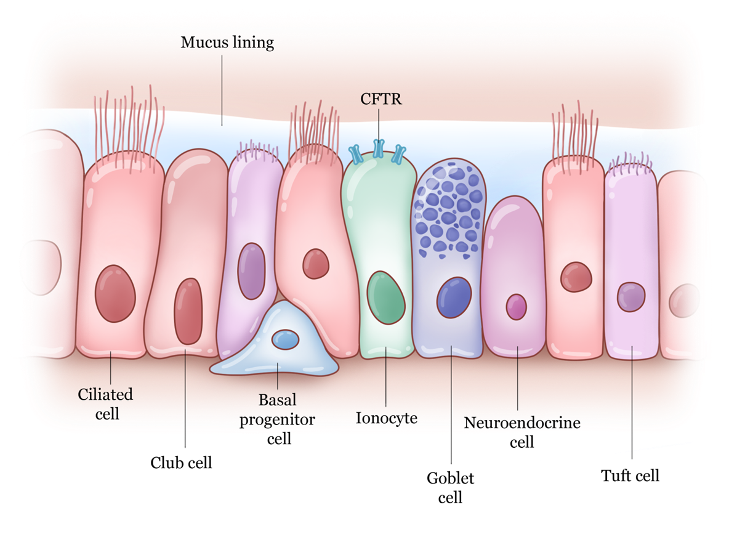
RESPIRATORY TRACT
Figure 1.3 Respiratory Epithelium

Slide 6
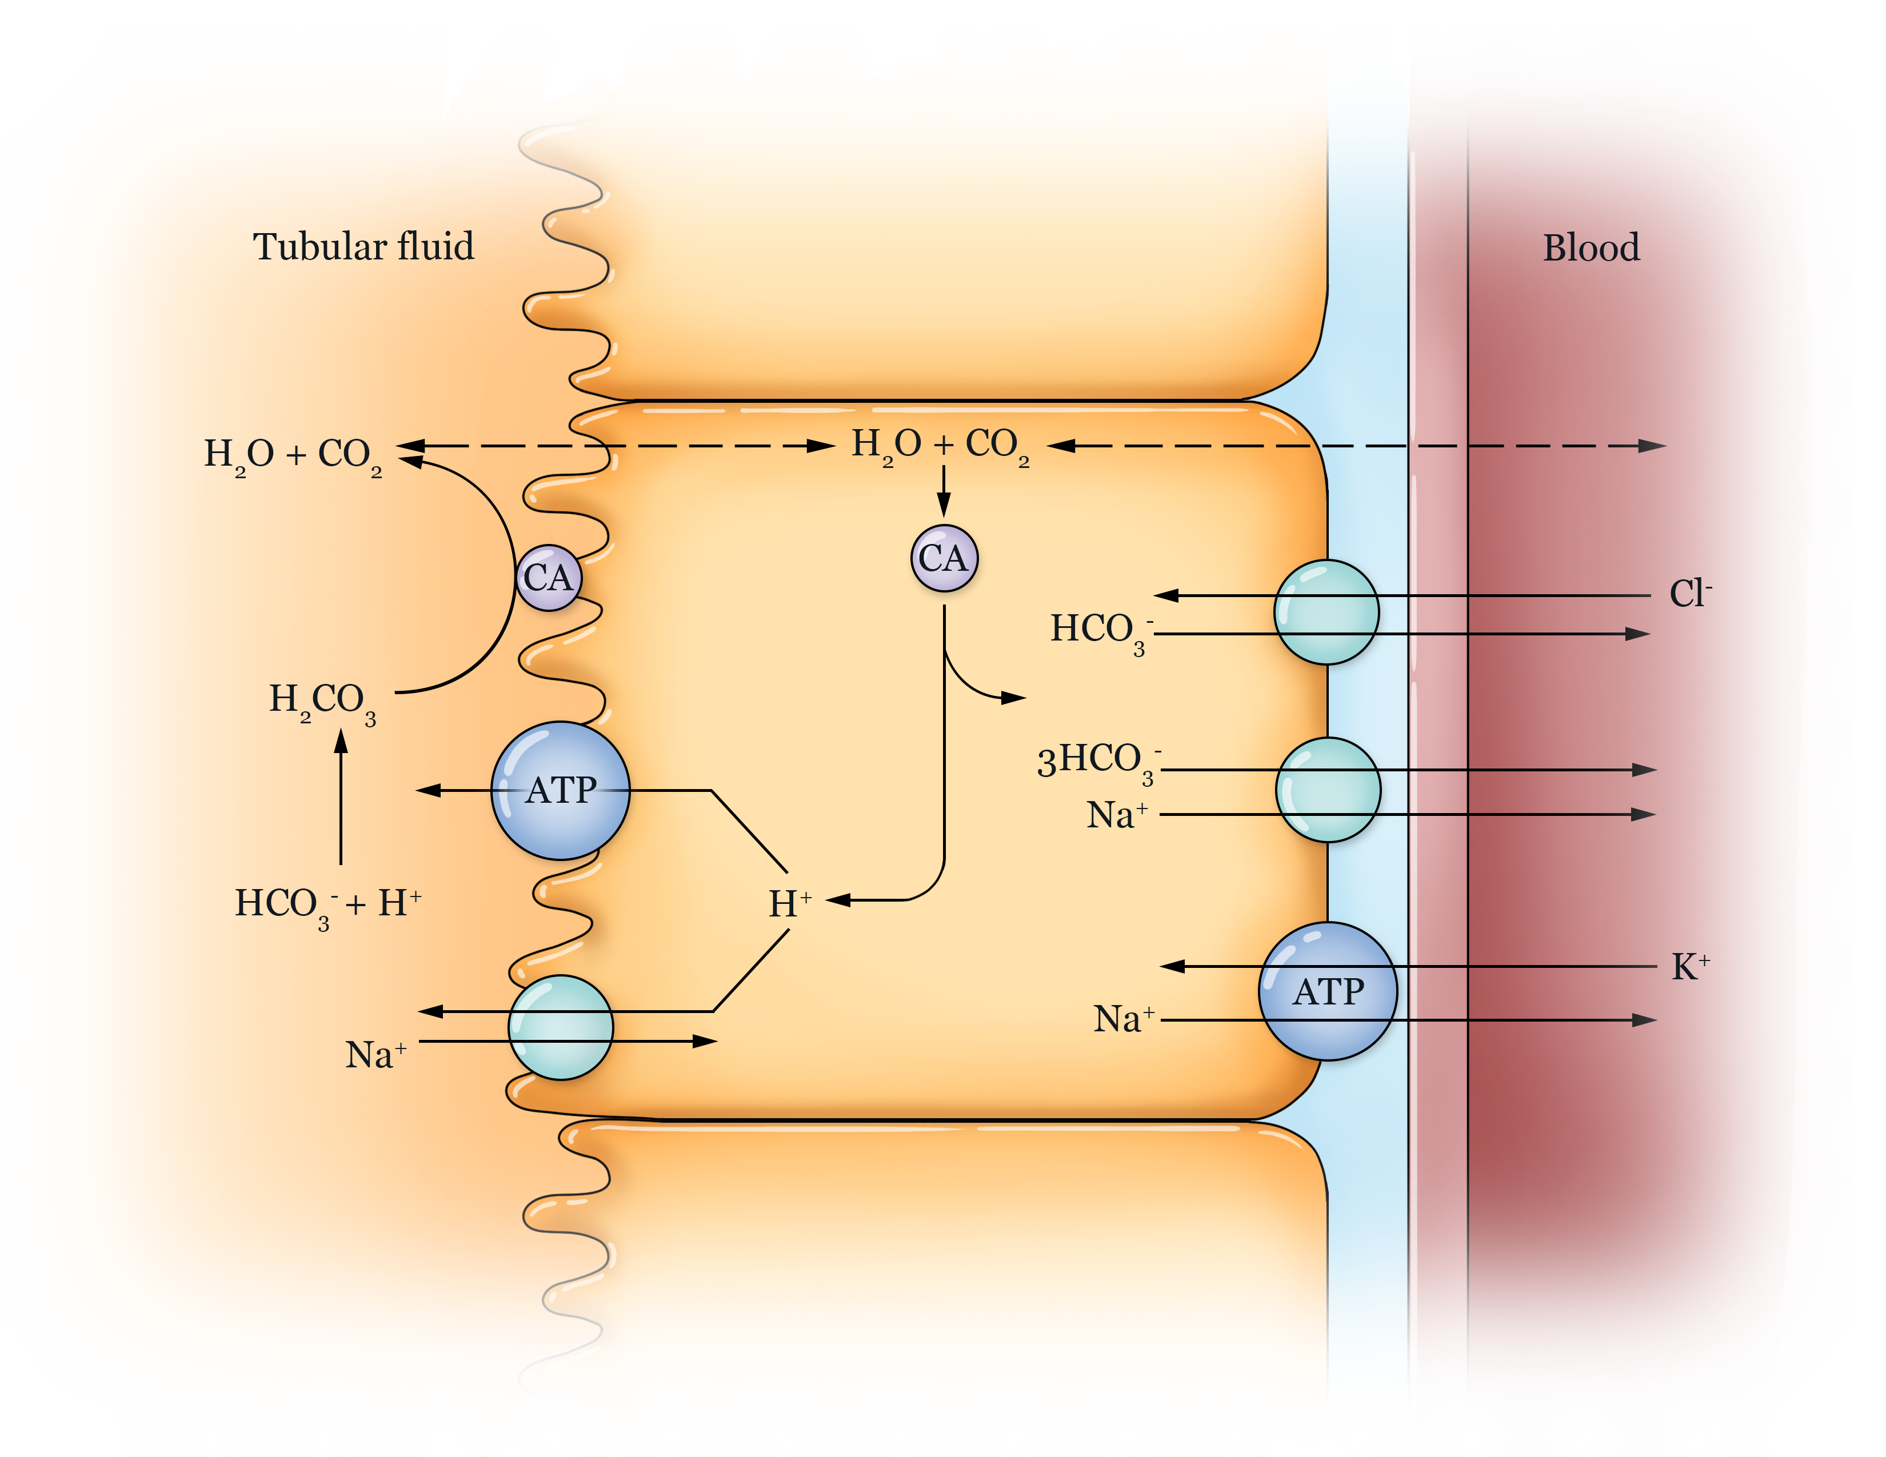
RENAL CELLS
Figure 1.4 Proximal Convoluted Tubule

Slide 7
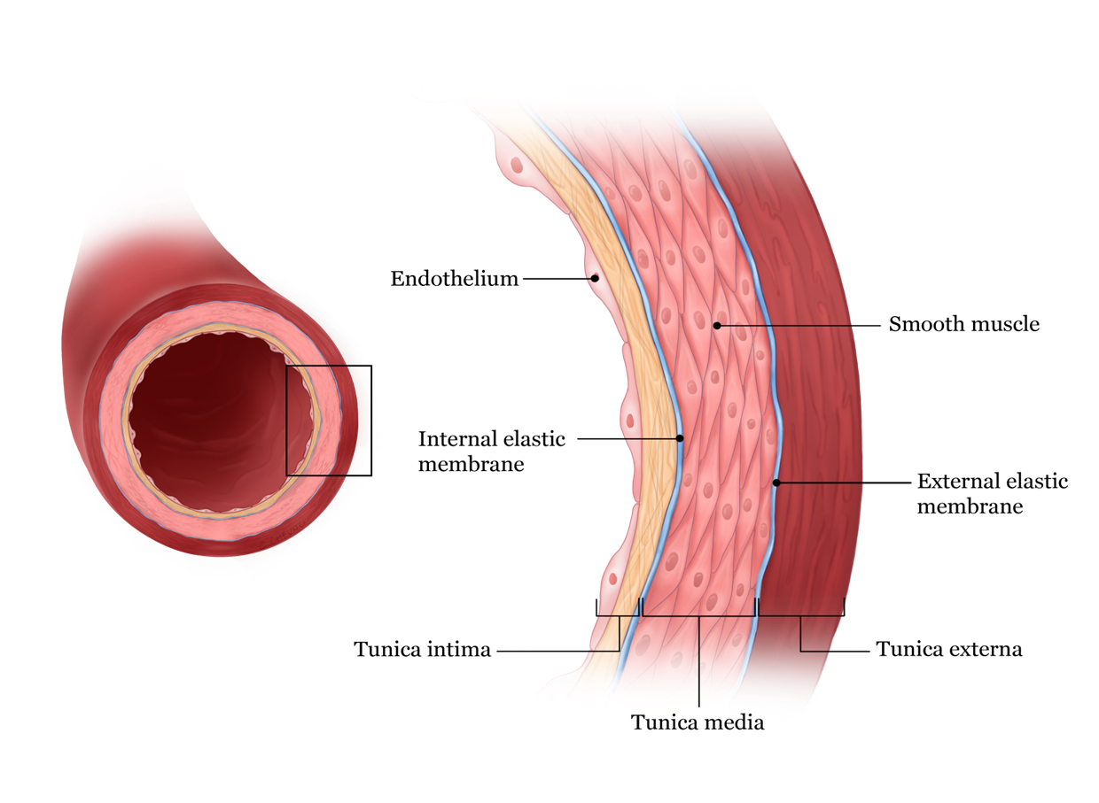
Vascular Endothelium
Figure 1.5 Blood Vessel Surface

Slide 8
Vasculitis
Inflammation of blood vessels
Labs: Low platelets; anemia; increased bleeding time
Peripheral smear: Schistocytes (Torn RBC’s and platelets
Notes:
Need time stamp

Slide 9
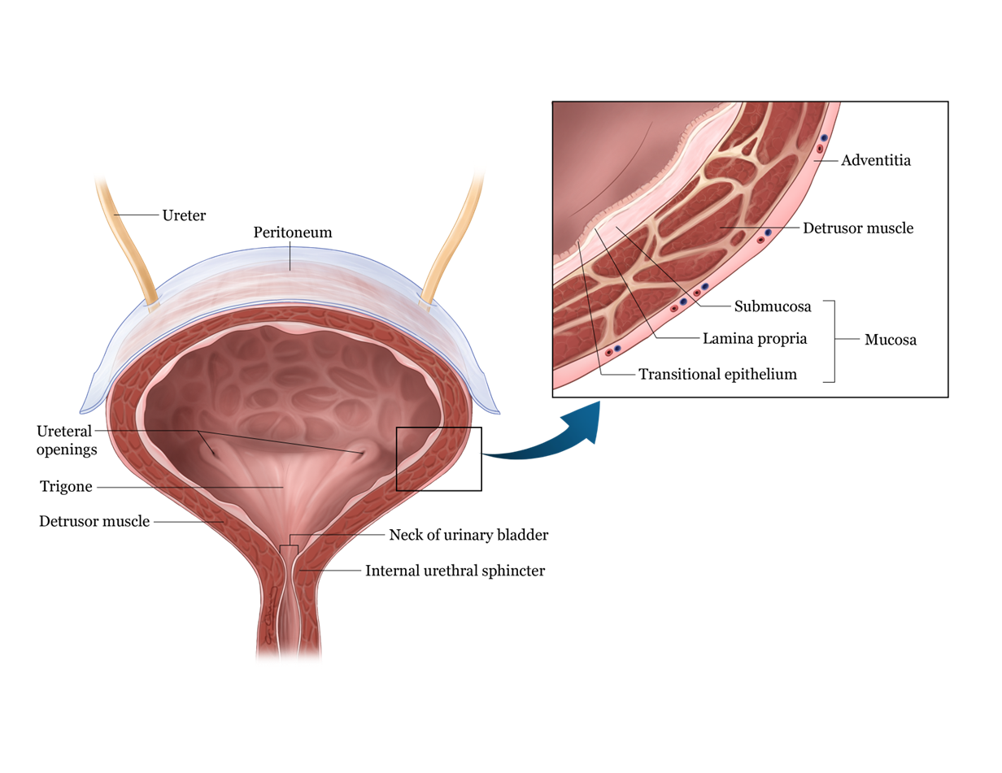
BLADDER CELLS
Figure 1.6 Bladder Wall

Slide 10
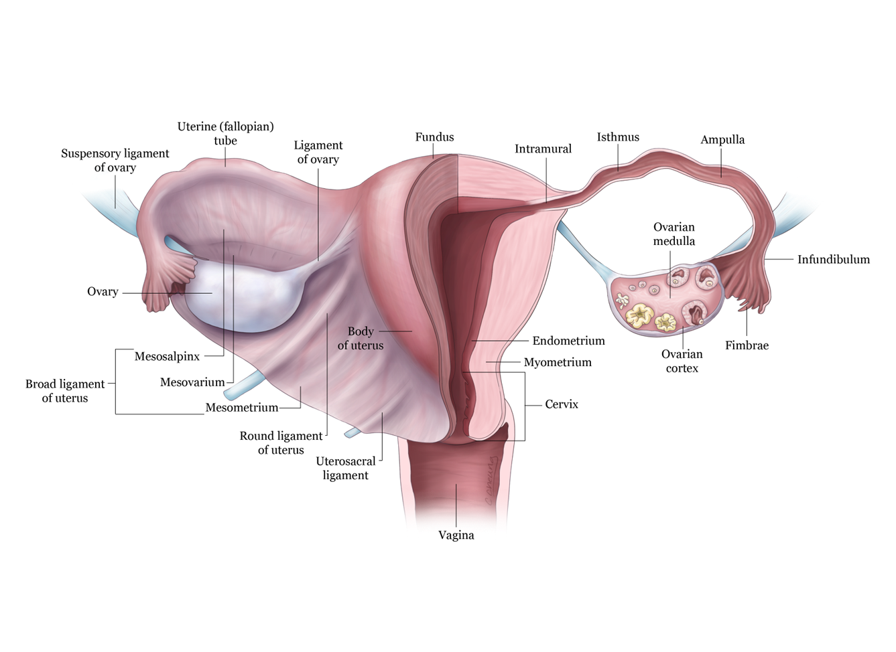
UTERINE CELLS
Figure 1.7 Uterine Wall

Slide 11
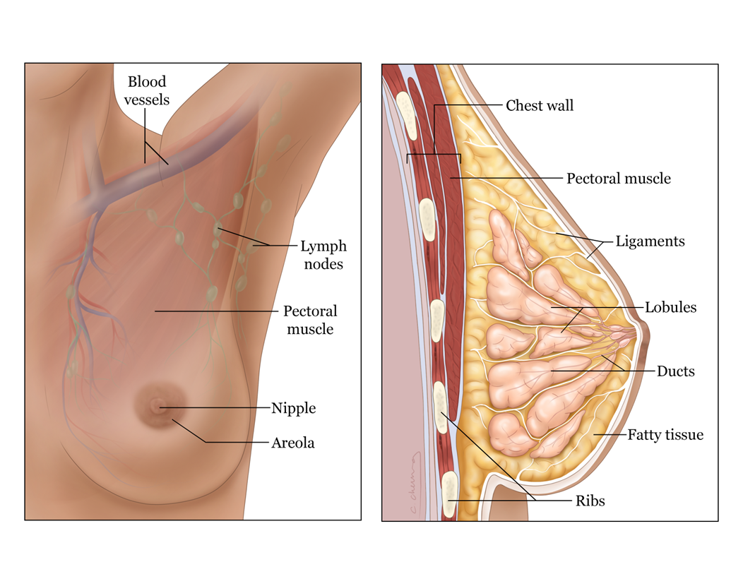
BREAST CELLS
Figure 1.8 Breast Tissue

Slide 12
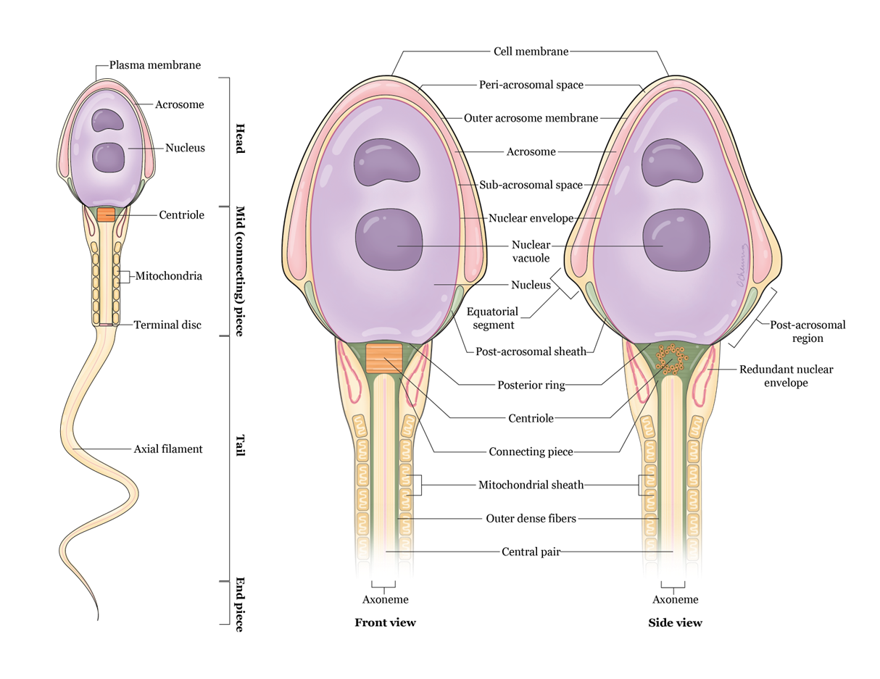
SPERM CELLS
Figure 1.9 Sperm

Slide 13
Germ Cells
May be called upon to divide at ANY moment
Needed for Apoptosis, Necrosis, and Mutated cells
Notes:
Need time stamp

Slide 14
Apoptosis
Scheduled cellular death
P53: gene that controls it
D-Cyclins: protein that controls it
Phosphatidylserine: the label for the cells
Caspases: the enzymes that carry out the process
Notes:
Need time stamp

Slide 15
Necrosis
Accidental injuries, infections, etc.

Slide 16
Mutations
Can occur at any time. Due to radiation exposure
Most commonly seen in the:
  Skin
  GI Tract
  Bone Marrow
Notes:
Need time stamp

Slide 17
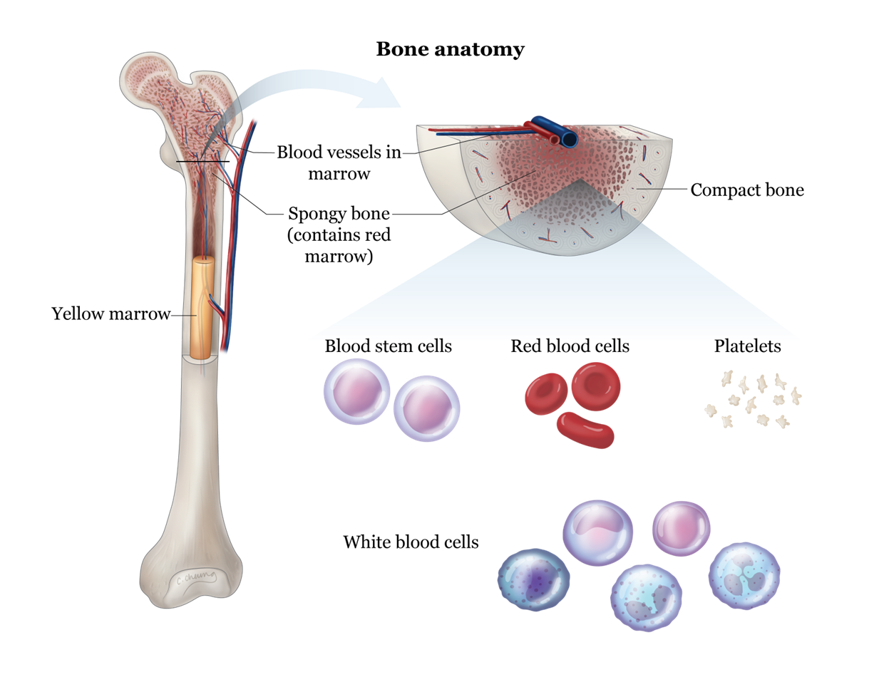
BONE MARROW CELLS
Figure 1.10 Bone Marrow

Slide 18
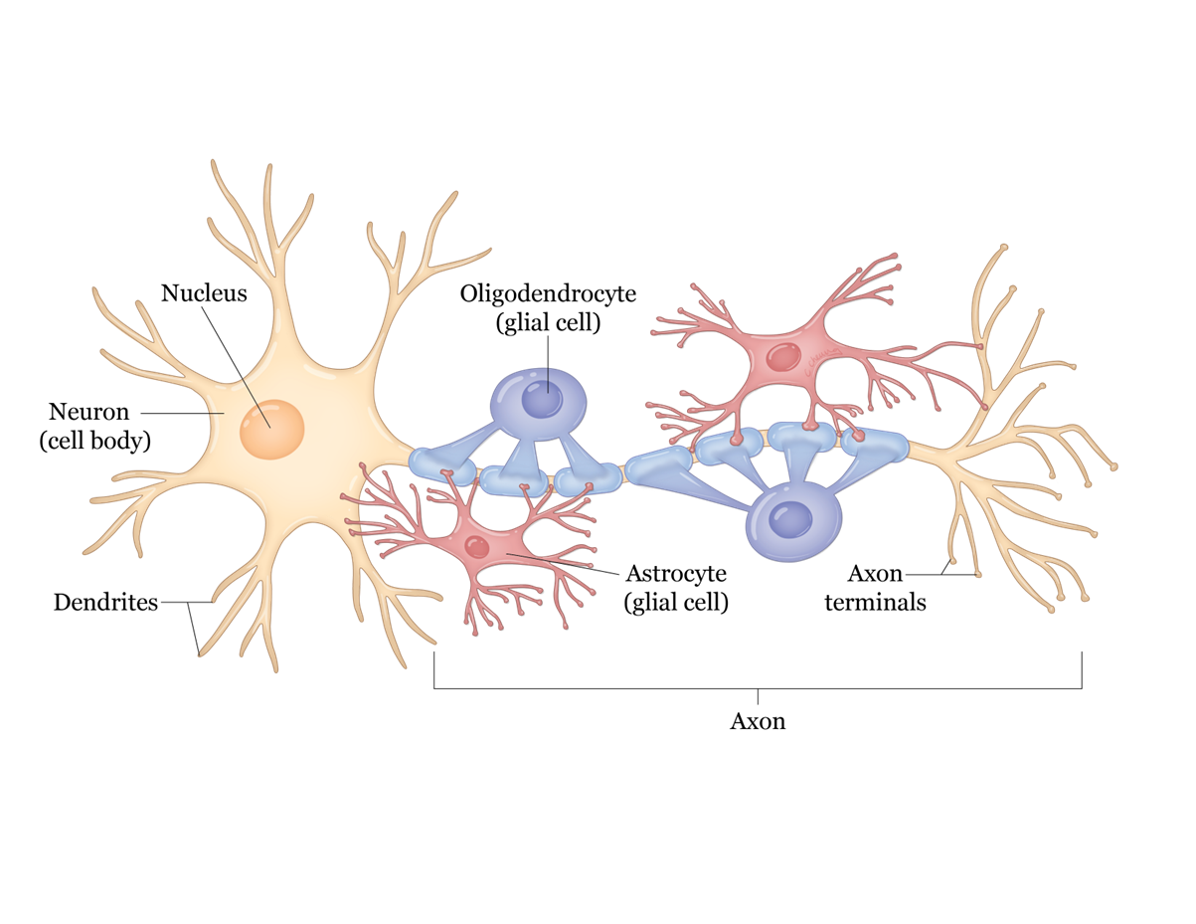
BRAIN CELLS
Figure 1.11 Brain Cells

Slide 19
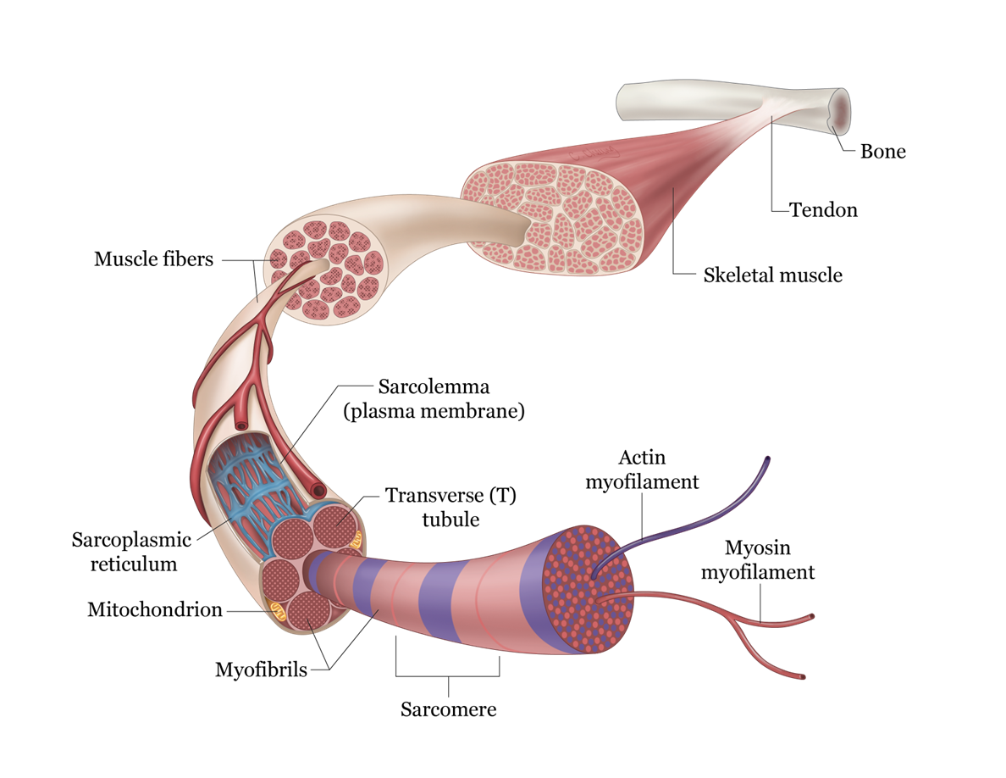
MUSCLE CELLS
Figure 1.12 Muscle Cells

Slide 20
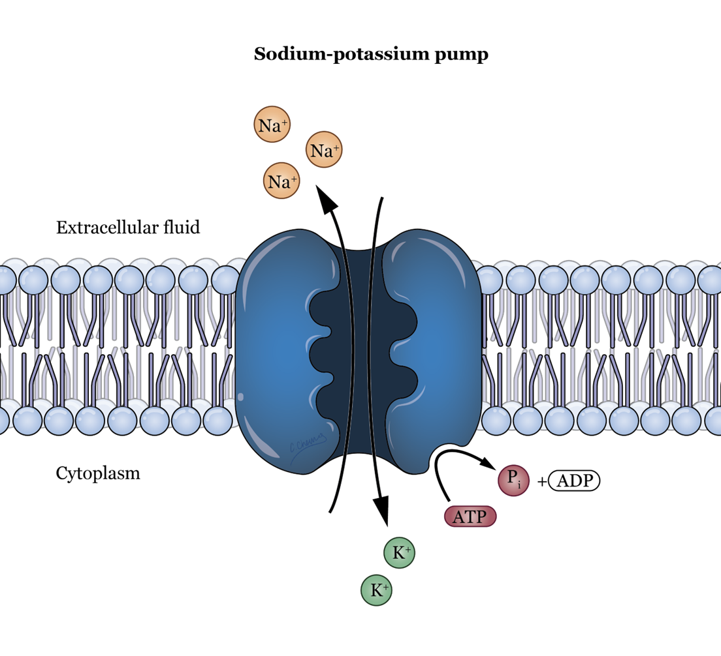
PRIMARY ACTIVE TRANSPORT
Figure 1.13 Sodium/Potassium Pump

Slide 21
Swelling
The very FIRST SIGN of inflammation in any illness
Notes:
Need time stamp

Slide 22
How to Create a Disease or Syndrome
Disease vs. Syndrome
A disease involves one organ
A syndrome involves more than one organ. It may also be the progression of a disease
When it bothers the patient enough, he or she will see the doctor as soon as possible
  WEAKNESS so that the patient can not go to work
  SHORTNESS OF BREATH scares people; they think they might die

Slide 23
Signs Of Disease
What do you see?
Tachypnea (breathing rate increased)
Dyspnea (having trouble breathing)
These are the most common signs of the low energy state

Slide 24
Symptoms Of Disease
What you hear the patient complain of
Weakness
Shortness of breath
These are the most common symptoms

Slide 25
Most Common Infections
What infections will tell you that a patient is in a low-energy state?
Pulmonary infections
  Because the patient cannot move the cilia to clean out the lung
Urinary tract infections
  Because the patient cannot contract their bladder to empty urine and expel microbes

Slide 26
Concept of Complications
Most IMPORTANT organs!
  Brain
  Heart
  Kidneys
Notes:
Need time stamp

Slide 27
Concept of Sacrifice
Kidneys
Heart
Brain last
Notes:
Need time stamp

Slide 28
Other Complications
A disease will begin in one tissue or organ. However, when it affects another tissue or organ, the second tissue involvement becomes a complication.
Dry skin
Hair dry and brittle
Nails brittle
Bone marrow suppressed
  Anemia
  Leukopenia
  Thrombocytopenia

Slide 29
Complications Cont.
Endothelium – atrophic
Endometrium – atrophic
Breasts – atrophic
Sperm count – low
GI – nausea, vomiting and diarrhea
Renal- PCT shuts down
Bladder – atrophic; leads to UTIs
Respiratory – weak cough > infections
Germ cells – unable to replicate > leads to skin and GI cancers
CNS - MR (children) and dementia (adults)
CV – heart failure

Slide 30
Cancers Related to Low Energy State
Skin Cancer
GI Cancer
Bone Marrow Cancer

Slide 31
Most Common Cancers in Men
Prostate Cancer
Lung Cancer
Colon Cancer

Slide 32
Most Common Cancer in Women
Breast Cancer
Lung Cancer
Colon Cancer

Slide 33
MOST COMMON CAUSE OF DEATH?
HEART FAILURE

Slide 34
ANYTIME YOU CAN CONNECT TO THE LOW ENERGY STATE …
APPLY THE ENTIRE CONCEPT
THIS ACCOUNTS FOR APPROXIMATELY 98% OF ILLNESSES
WHENEVER IN DOUBT > ASSUME IT IS A LOW ENERGY STATE
STOP GUESSING!!!

Slide 35
You Have Been Empowered!

